Slide 1
Introduction to DeployR
R tutorials and networking with Data scientists
Brijraj Singh
Sr. Tech. Evangelist
brsingh@Microsoft.com
@brijrajsingh

Slide 2
What is DeployR
DeployR is an integration technology for deploying R analytics in web, desktop, mobile and backend systems.
Turns your R scripts into analytics web services.
Help the developers integrate R analytics into their applications without knowledge about R
DeployR enterprise provides scalability and security for business critical applications.

Slide 3
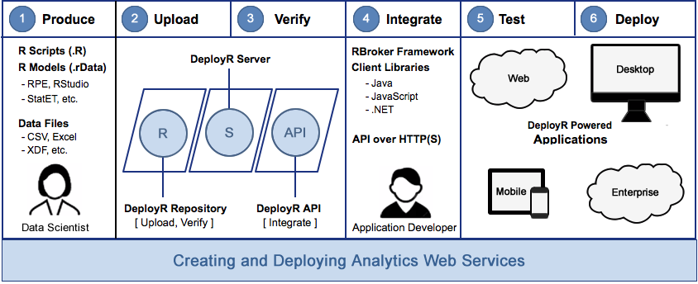
Basic Workflow

Slide 4
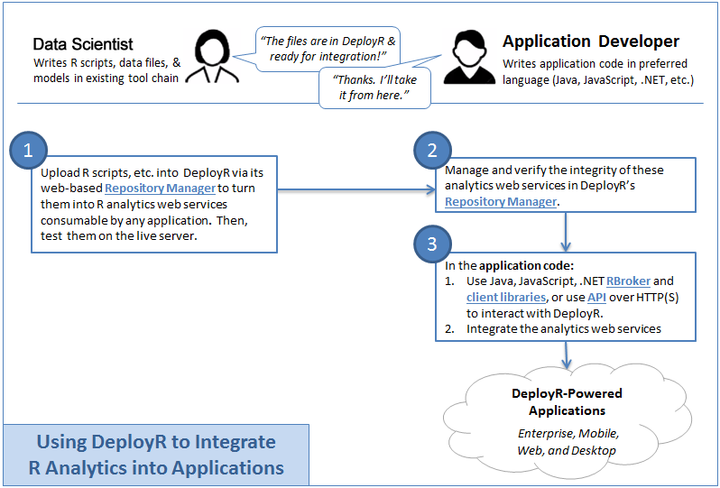
Data Scientist – Developer collaboration

Slide 5
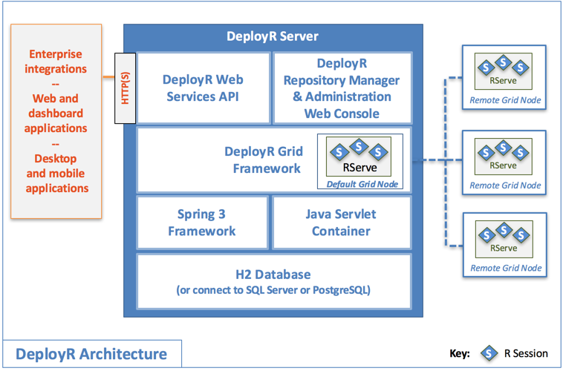
DeployR Architecture

Slide 6
Where do I get it from ?
DeployR open is available on http://mran.microsoft.com/
DeployR enterprise – comes pre-installed with Microsoft R server.
Microsoft R server is available on – windows, Linux SUSE and Mac OSX

Slide 7
Demo
Check out the infrastructure – Microsoft R server on Linux
Check out the DeployR dashboards
Run R scripts on server
Run R scripts as a webservice from a .net client

Slide 8
Thanks !
Know more about DeployR from here - https://msdn.microsoft.com/en-us/microsoft-r/deployr-about
Demos and this ppt can be found here - https://github.com/brijrajsingh/RDemo
brsingh@Microsoft.com
@brijrajsingh

